Slide 1
Benefits Claims Decision Support System Date: 1/19/16 PM: Elizabeth Wollin
Schedule | Staffing | Funding | Integration | Stakeholder Comms | VBA Overall | OI&T Overall
 | ● | ● | N/A | ● | ● | ●
Cross Dependencies: N/A
Completed this Week:
Multiple meetings/calls with team
Data compilation and analysis efforts in support of Ear Model Construction
BCDS conceptual database design and architecture
JIRA use for managing requirements backlog, testing, and demonstration
Participated in DB review meetings.
Reviewed JIRA workflow status options. Provided feedback.
Analyzing Data and comparing to notebooks.
Reviewing Role-based security tables.
Completed Data architecture, team review (awaiting feedback)
Overdue:
None
Due Next Week:
Integrate feedback into data architecture
Multiple BCDS team design sessions
Discussions/Working Sessions to finalize data synthesis
Further Database analysis
Scrum process flow
RBAC model review

Slide 2
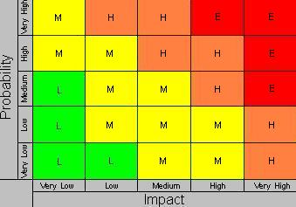
Benefits Claims Decision Support System Date: 12/11/15 PM: Elizabeth Wollin
Risk 1:
Title:
Risk: If delays in obtaining data.
Impact: The deliverables will be delayed.
Mitigation Steps to Date:
Regularly communicate timeline and data needs with VA PM.
Action Items:
VA PM working to obtain required agreements for data and data transfer.
Who: VA PM Due Date: Ongoing
Risk 2:
Title: Technical [12/11/15]
Risk: If expectations re: Mitre Scripts and Analysis duplication.
Impact: VA Stakeholder buy-in may not be obtained.
Mitigation Steps to Date:
Clearly Communication project approach and potential benefits with Business and Technical subject matter experts (SMEs).
Action Items:
Coordinates project meetings with Business and Technical SMEs.
Who: VA PM and Project Team Due Date: Ongoing
1
2

